Slide 1
BFS(Breadth-first search):
An algorithm for traversing or searching tree or graph data structures.
It starts at the tree root (or some arbitrary node of a graph, sometimes referred to as a 'search key’) and explores all of the neighbor nodes at the present depth prior to moving on to the nodes at the next depth level.
DFS(Depth-first search):
An algorithm for traversing or searching tree or graph data structures.
It starts at the root node (selecting some arbitrary node as the root node in the case of a graph) and explores as far as possible along each branch before backtracking.

Slide 2
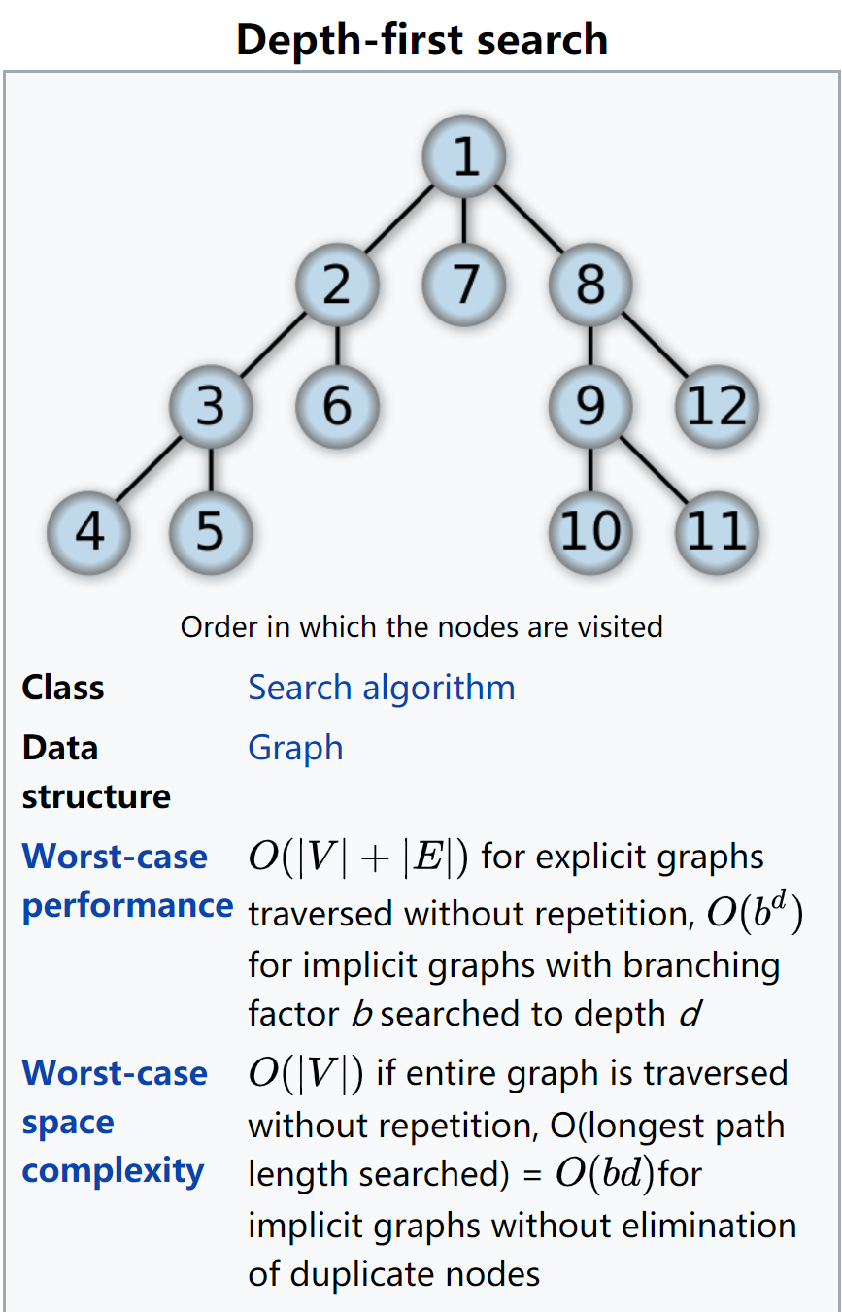
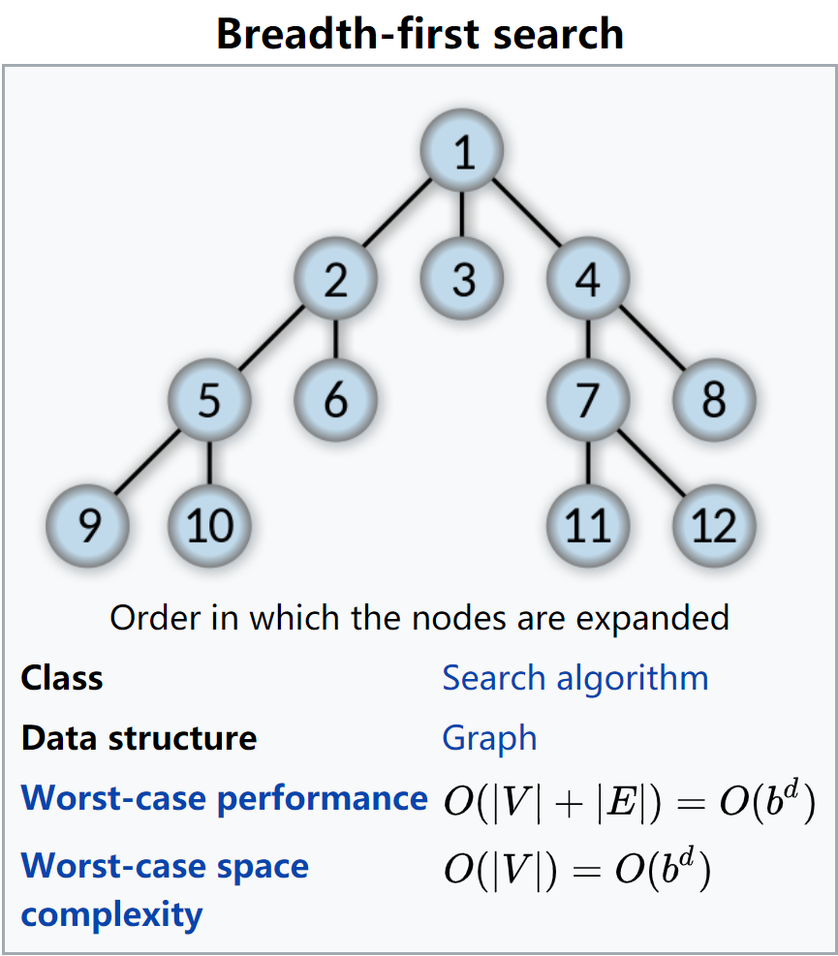

Slide 3
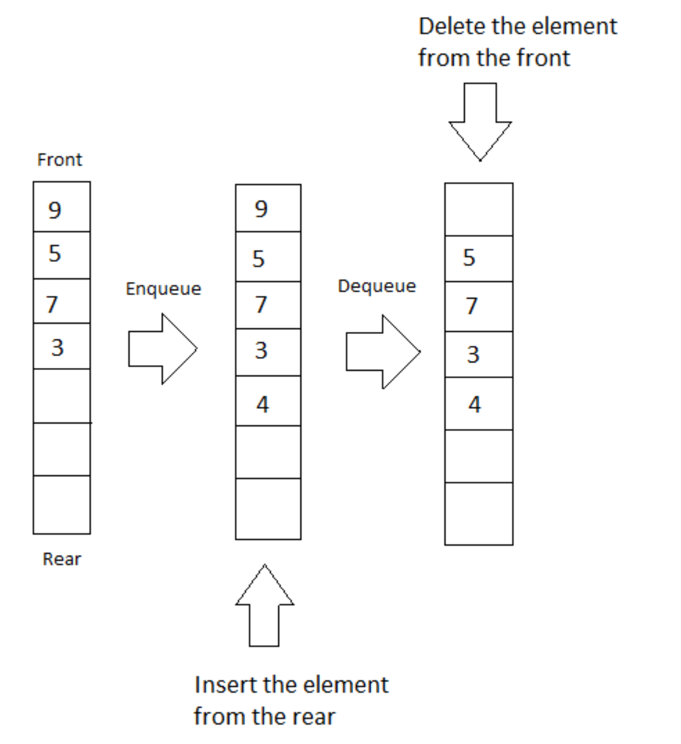
Queue: Queue is a data structure that follows the FIFO principle. FIFO means First In First Out i.e the element added first in the queue will be the one to be removed first. Elements are always added to the back and removed from the front. Think of it as a line of people waiting for a bus at the bus stand. The person who will come first will be the first one to enter the bus.

Slide 4
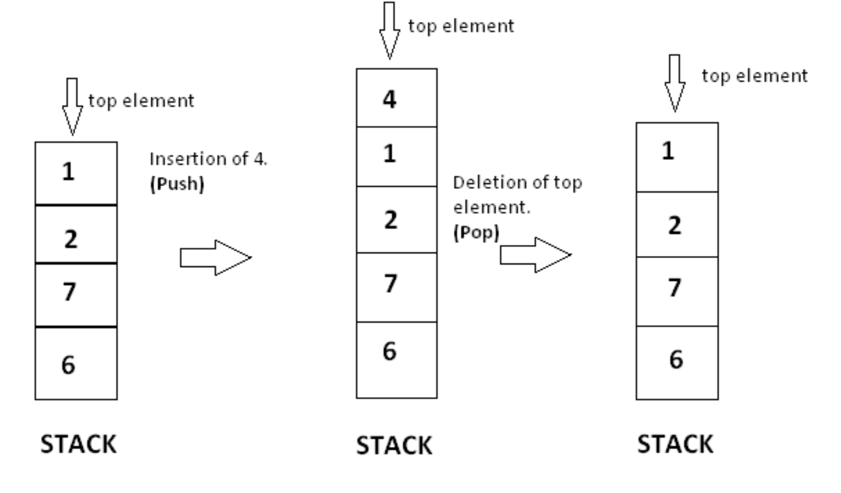
Stacks:
Stack is collection of elements, that follows the LIFO order. LIFO stands for Last In First Out, which means element which is inserted most recently will be removed first. Imagine a stack of tray on the table. When you put a tray there you put it at top, and when you remove it, you also remove it from top.
A stack has a restriction that insertion and deletion of element can only be done from only one end of stack and we call that position as top. The element at top position is called top element. Insertion of element is called PUSH and deletion is called POP.

Slide 5
Breadth-First Search with a Queue
In breadth-first search we explore all the nearest possibilities by finding all possible successors and enqueue them to a queue.
Create a queue
Create a new choice point
Enqueue the choice point onto the queue
while (not found and queue is not empty)
Dequeue the queue
Find all possible choices after the last one tried
Enqueue these choices onto the queue
Return
Deapth-First Search with a Stack
In depth-first search we go down a path until we get to a dead end; then we backtrack or back up (by popping a stack) to get an alternative path.
Create a stack
Create a new choice point
Push the choice point onto the stack
while (not found and stack is not empty)
Pop the stack
Find all possible choices after the last one tried
Push these choices onto the stack
Return

Slide 6
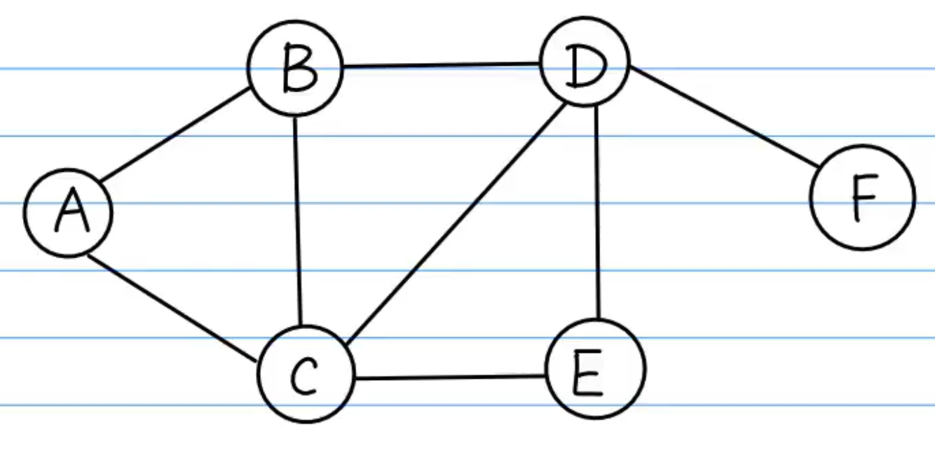
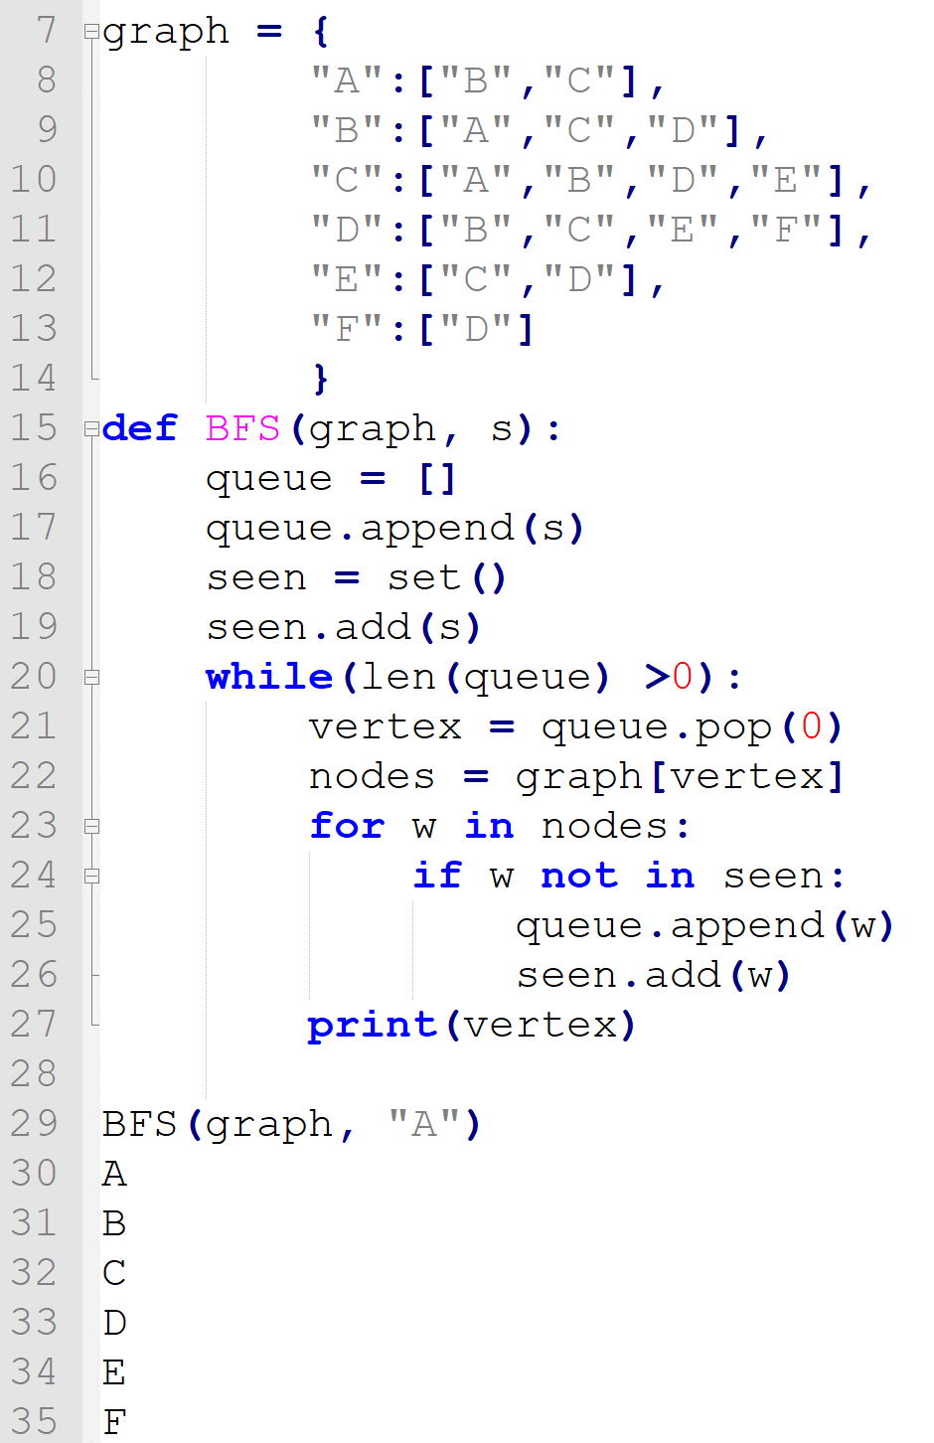
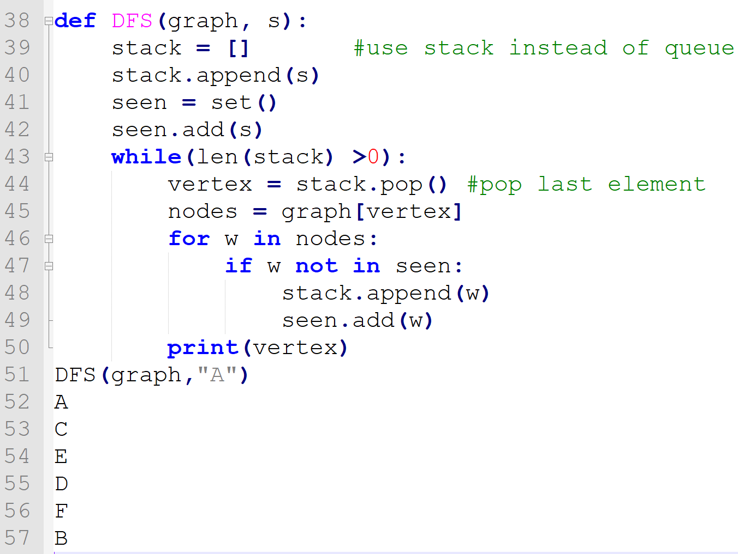

Slide 7
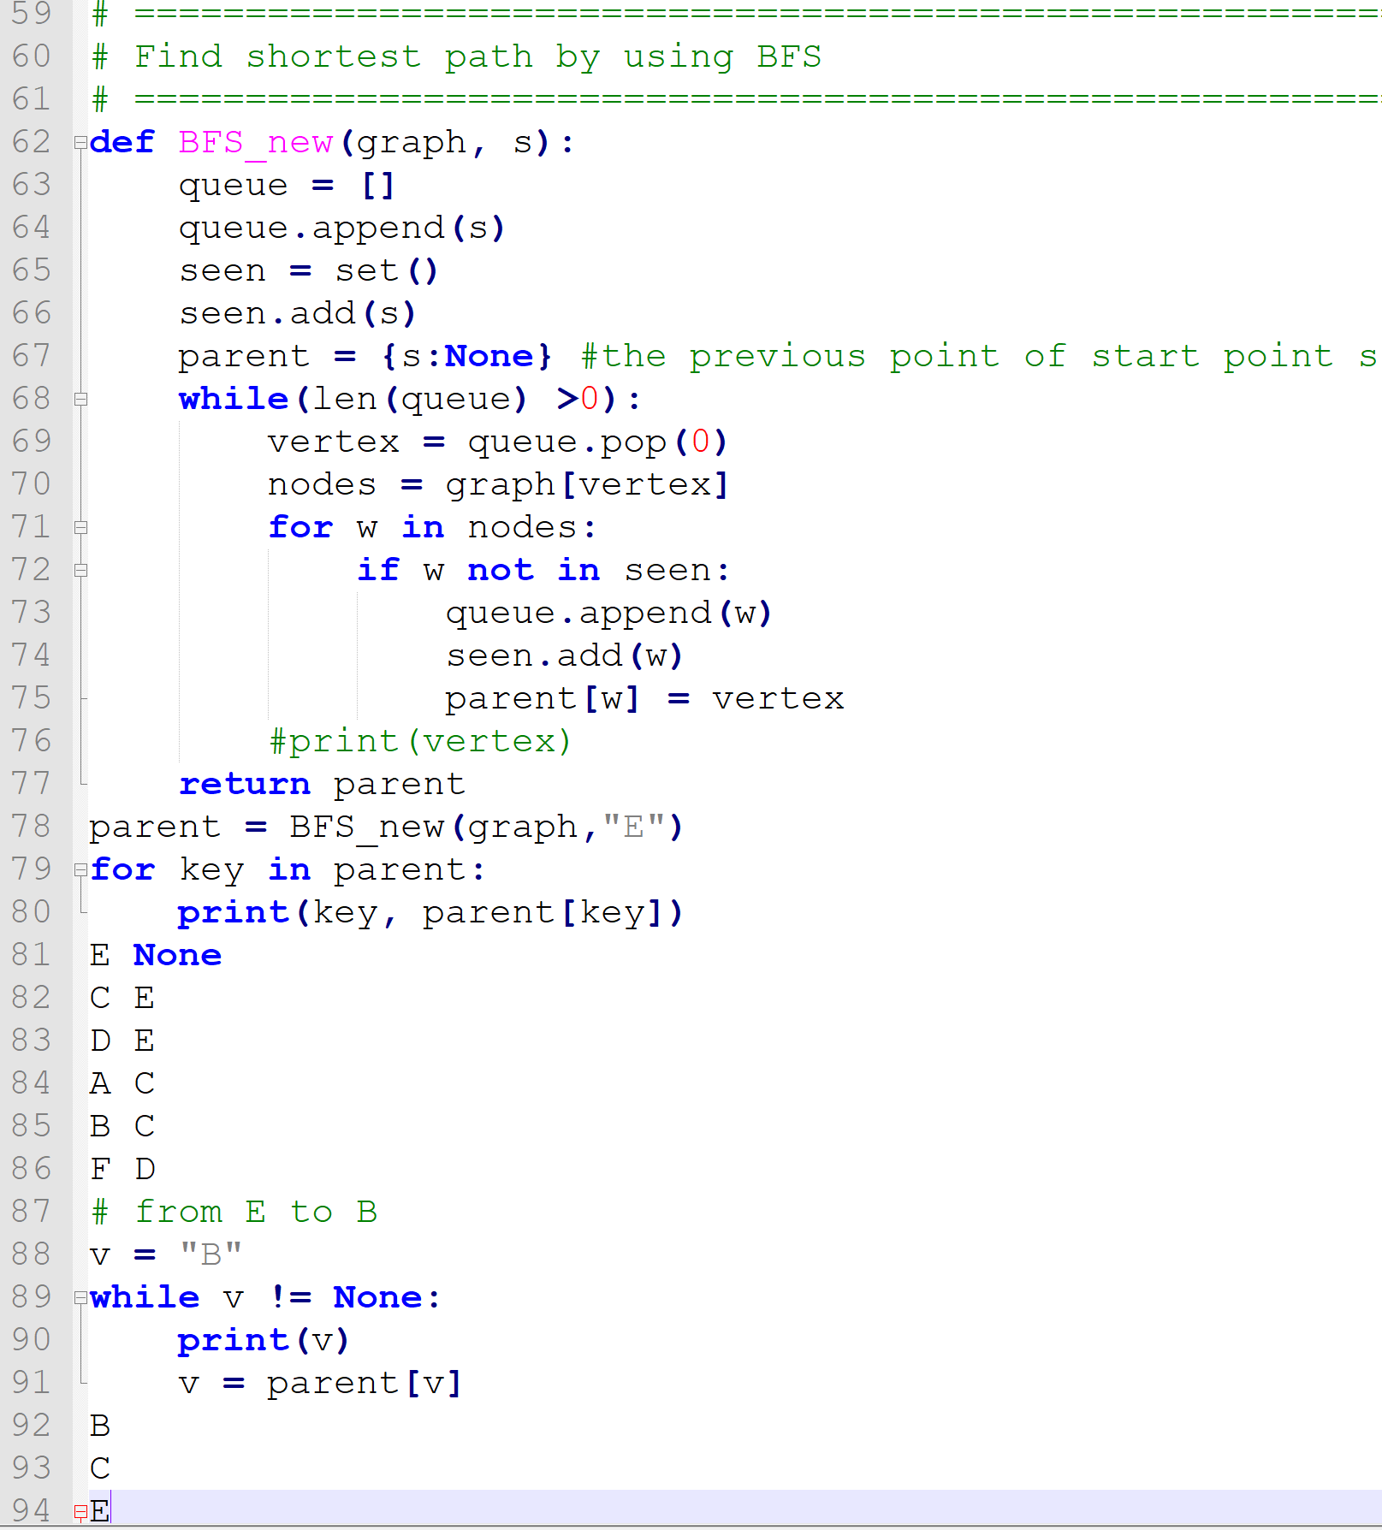
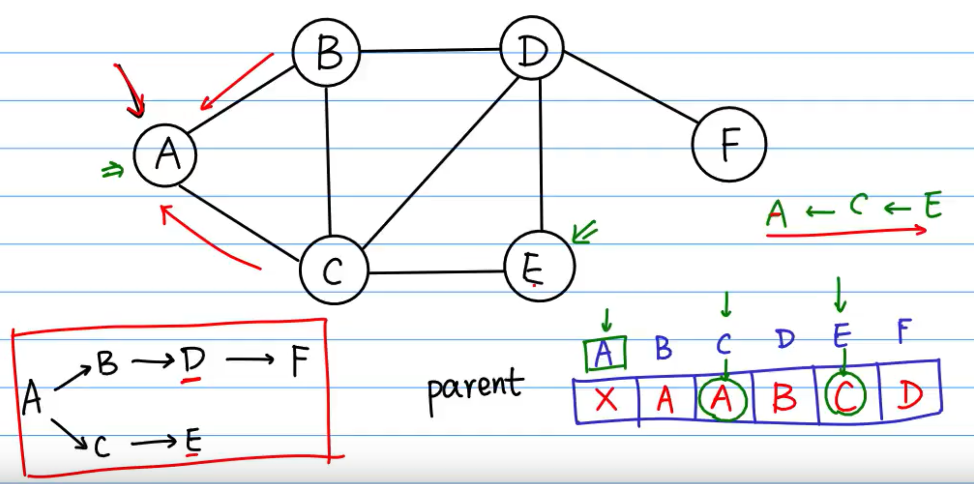
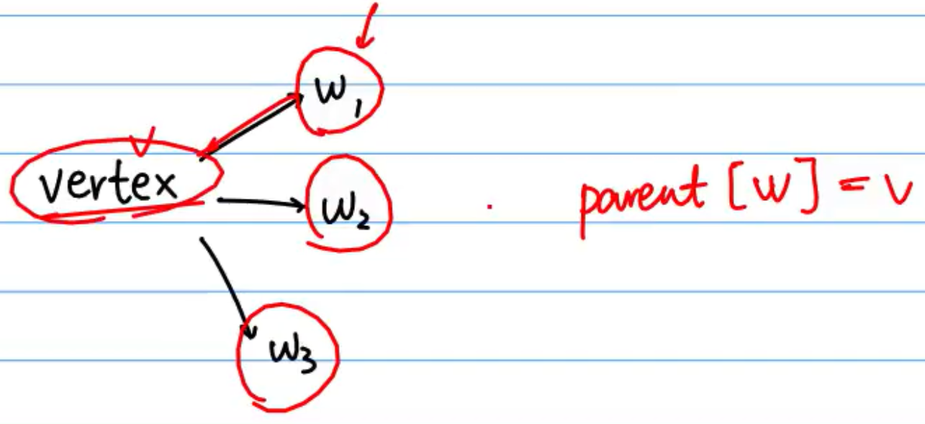
Find the shortest path by using BFS

Slide 8
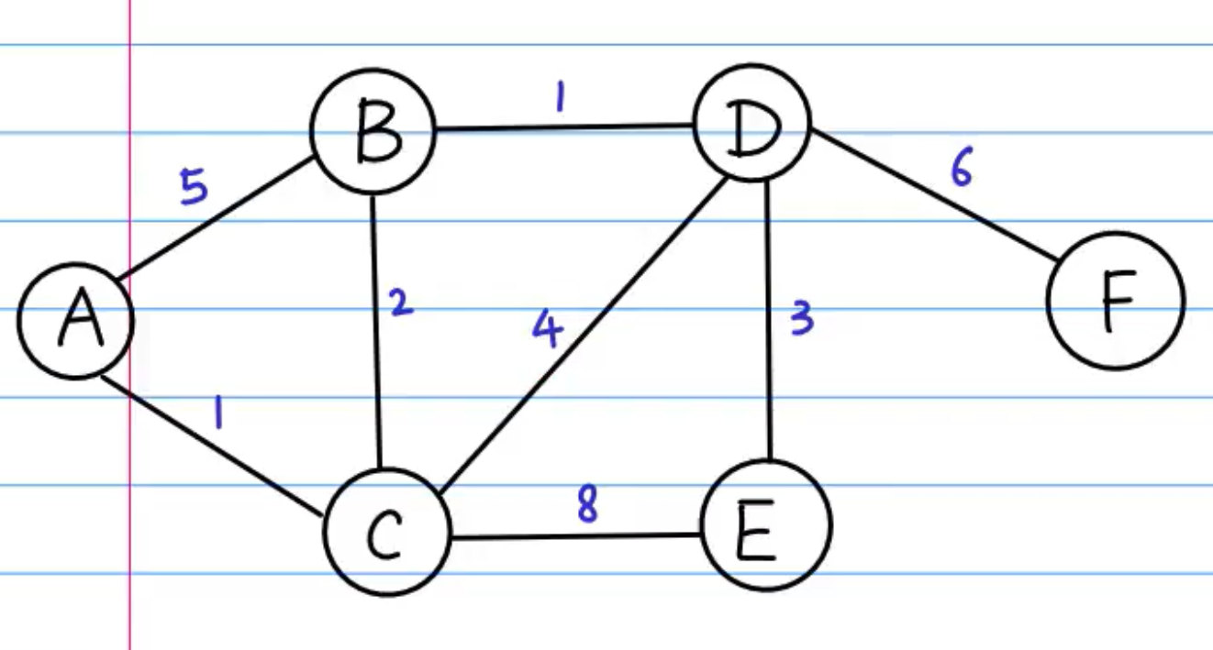
BFS→Dijkstra: Shortest path first algorithm
Dijkstra is an algorithm for finding the shortest paths between nodes in a graph, which may represent, for example, road networks.
Priority Queue is an extension of the queue with following properties. 1) An element with high priority is dequeued before an element with low priority. 2) If two elements have the same priority, they are served according to their order in the queue.
In Python:
The heapq module provides an implementation of the heap queue algorithm, also known as the priority queue algorithm.
Eg.
heapq.heappush(heap, item)
heapq.heappop(heap)

Slide 9
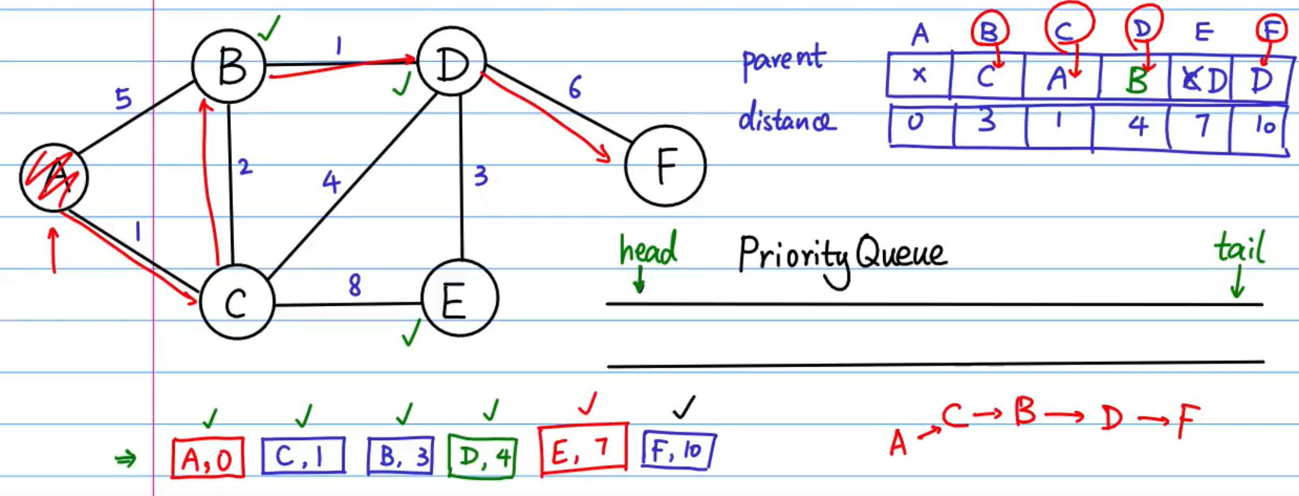
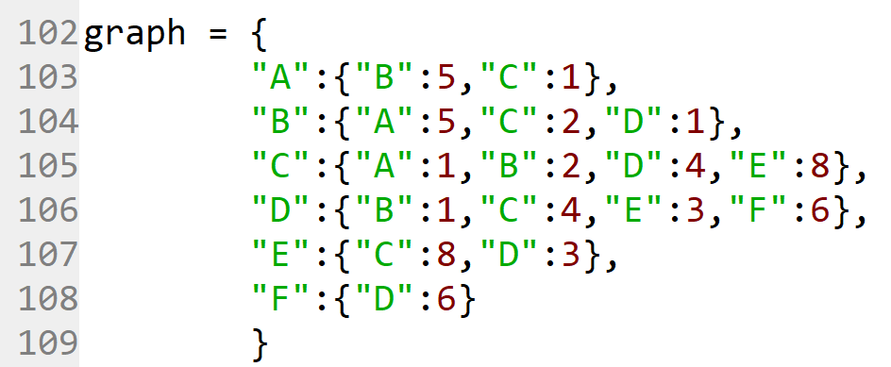

Slide 10
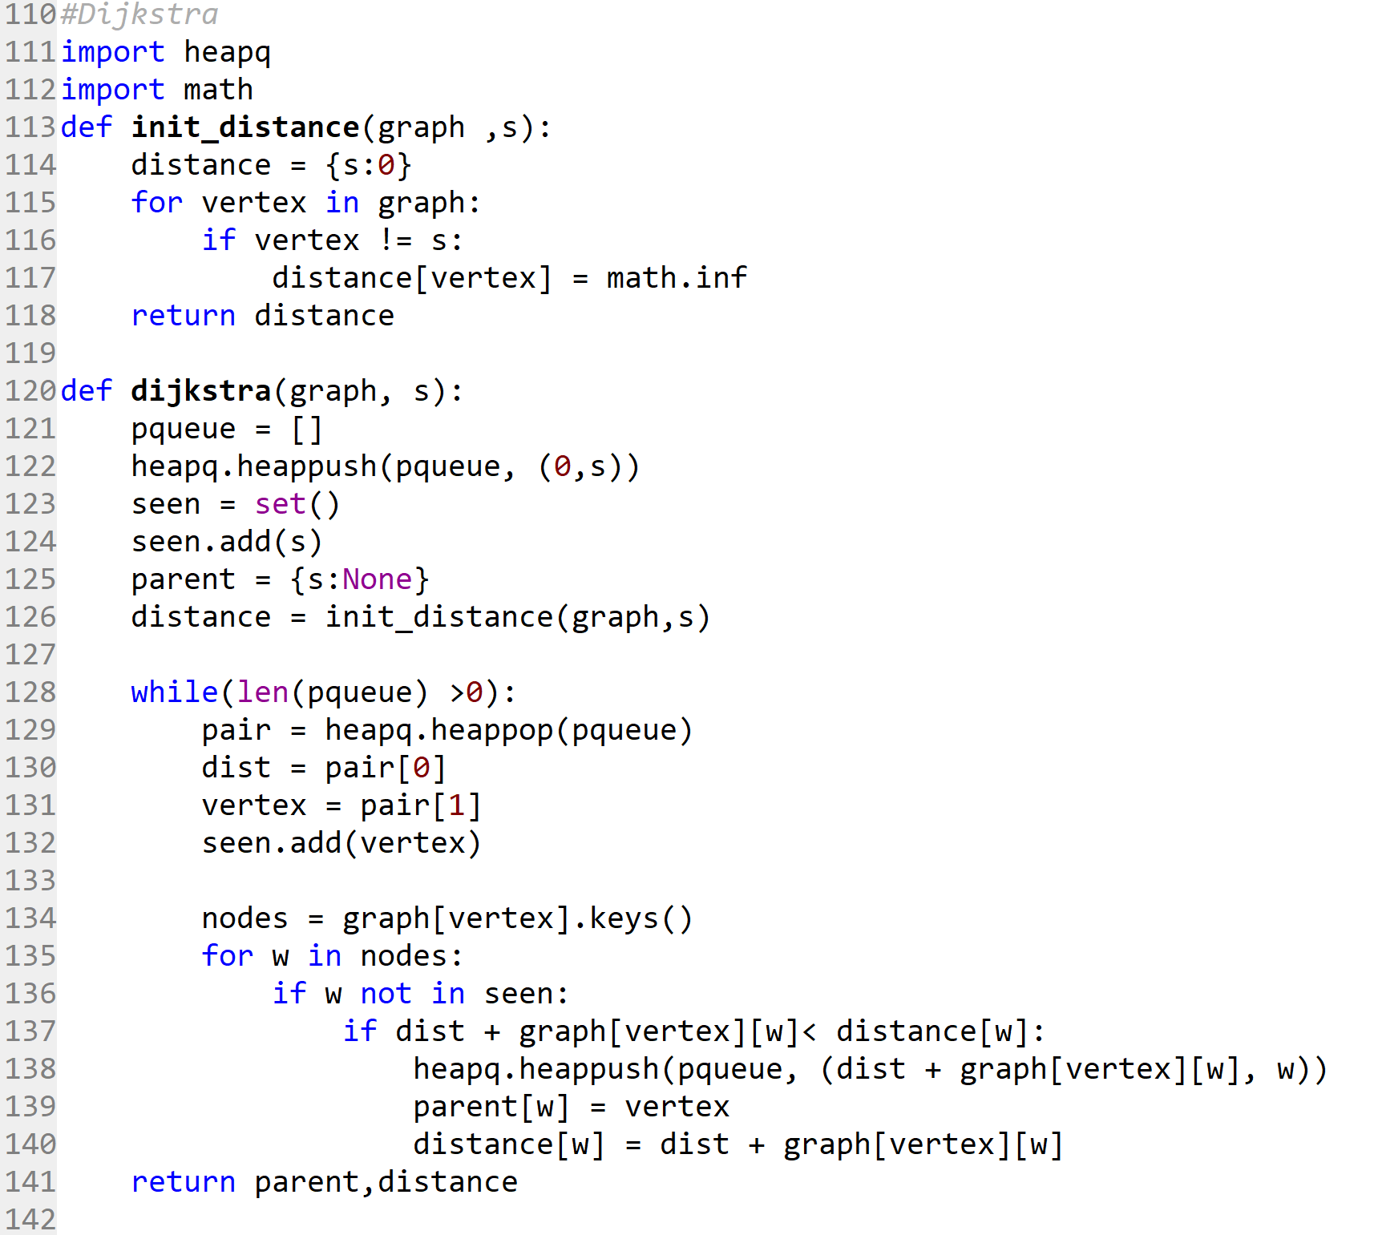
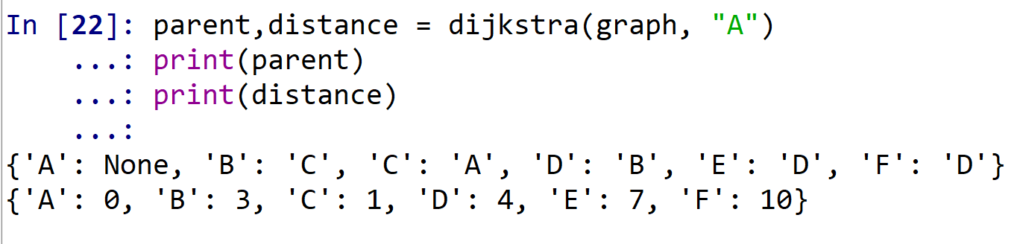
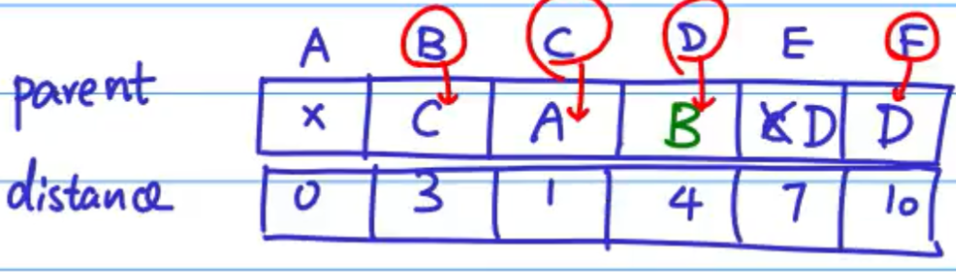

Slide 11
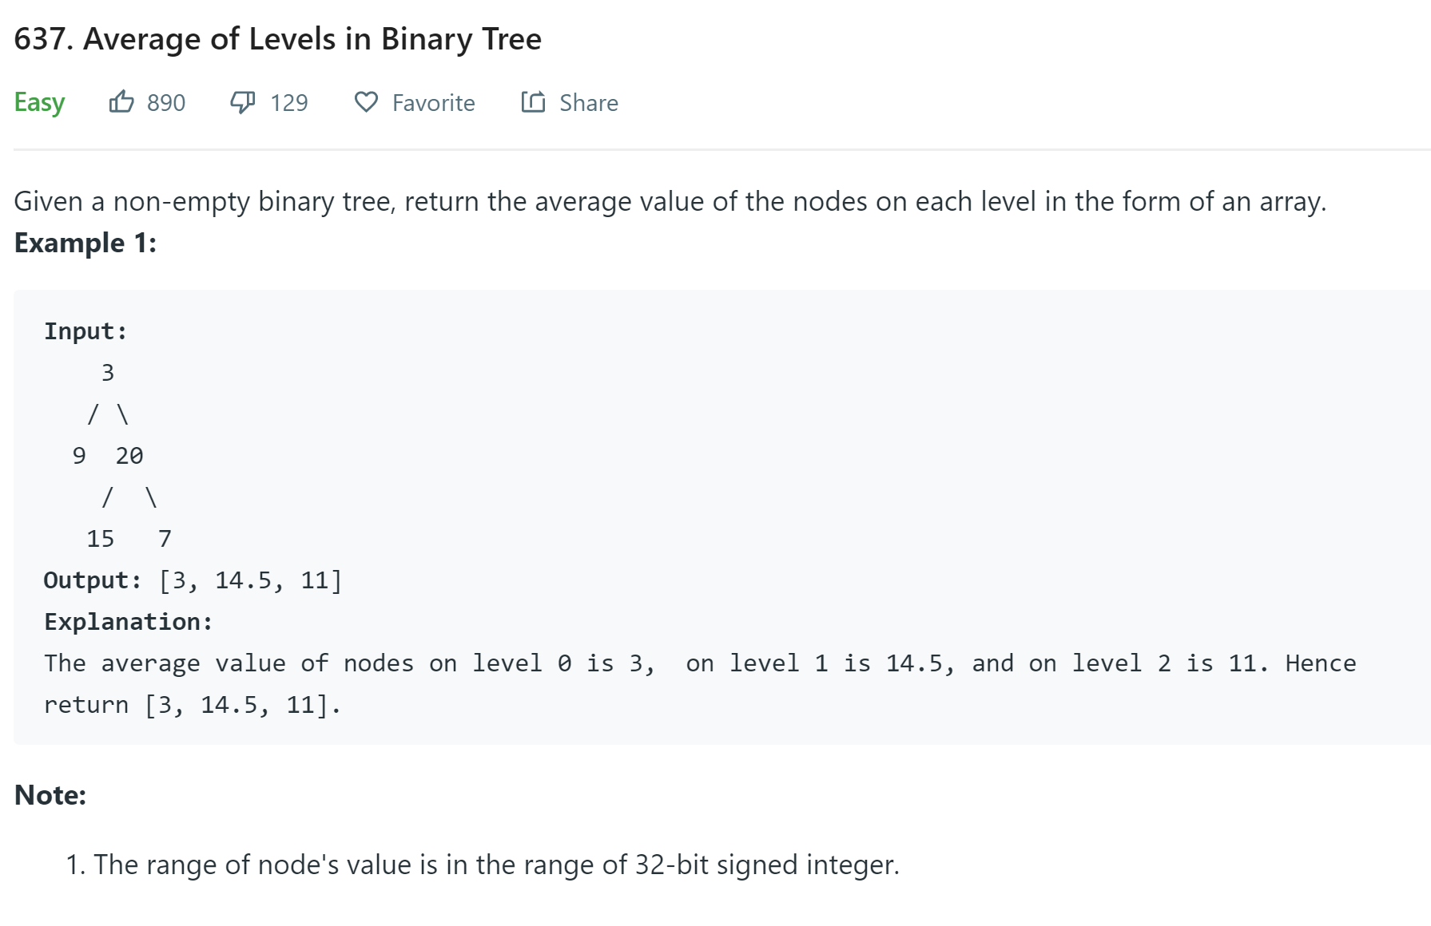

Slide 12
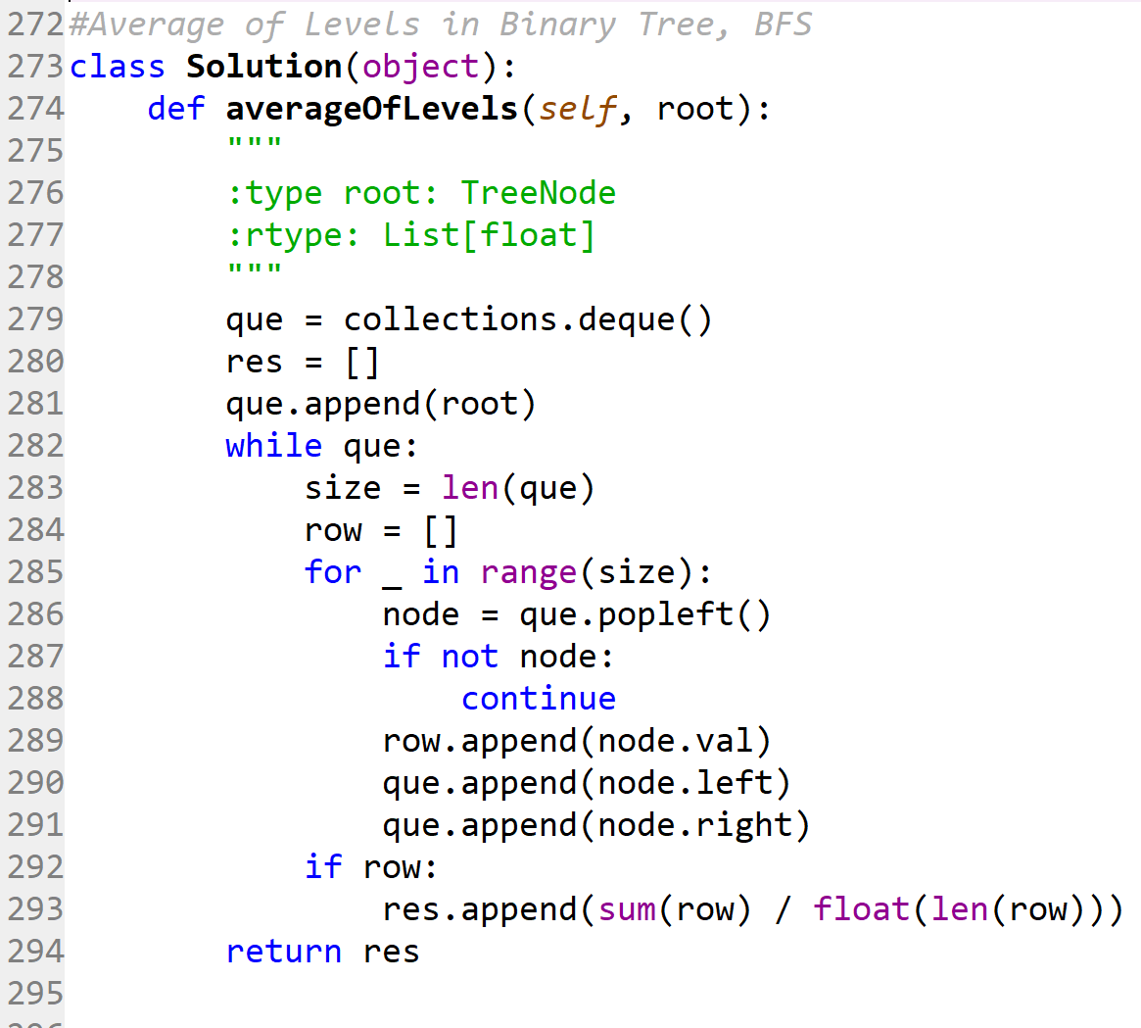

Slide 13
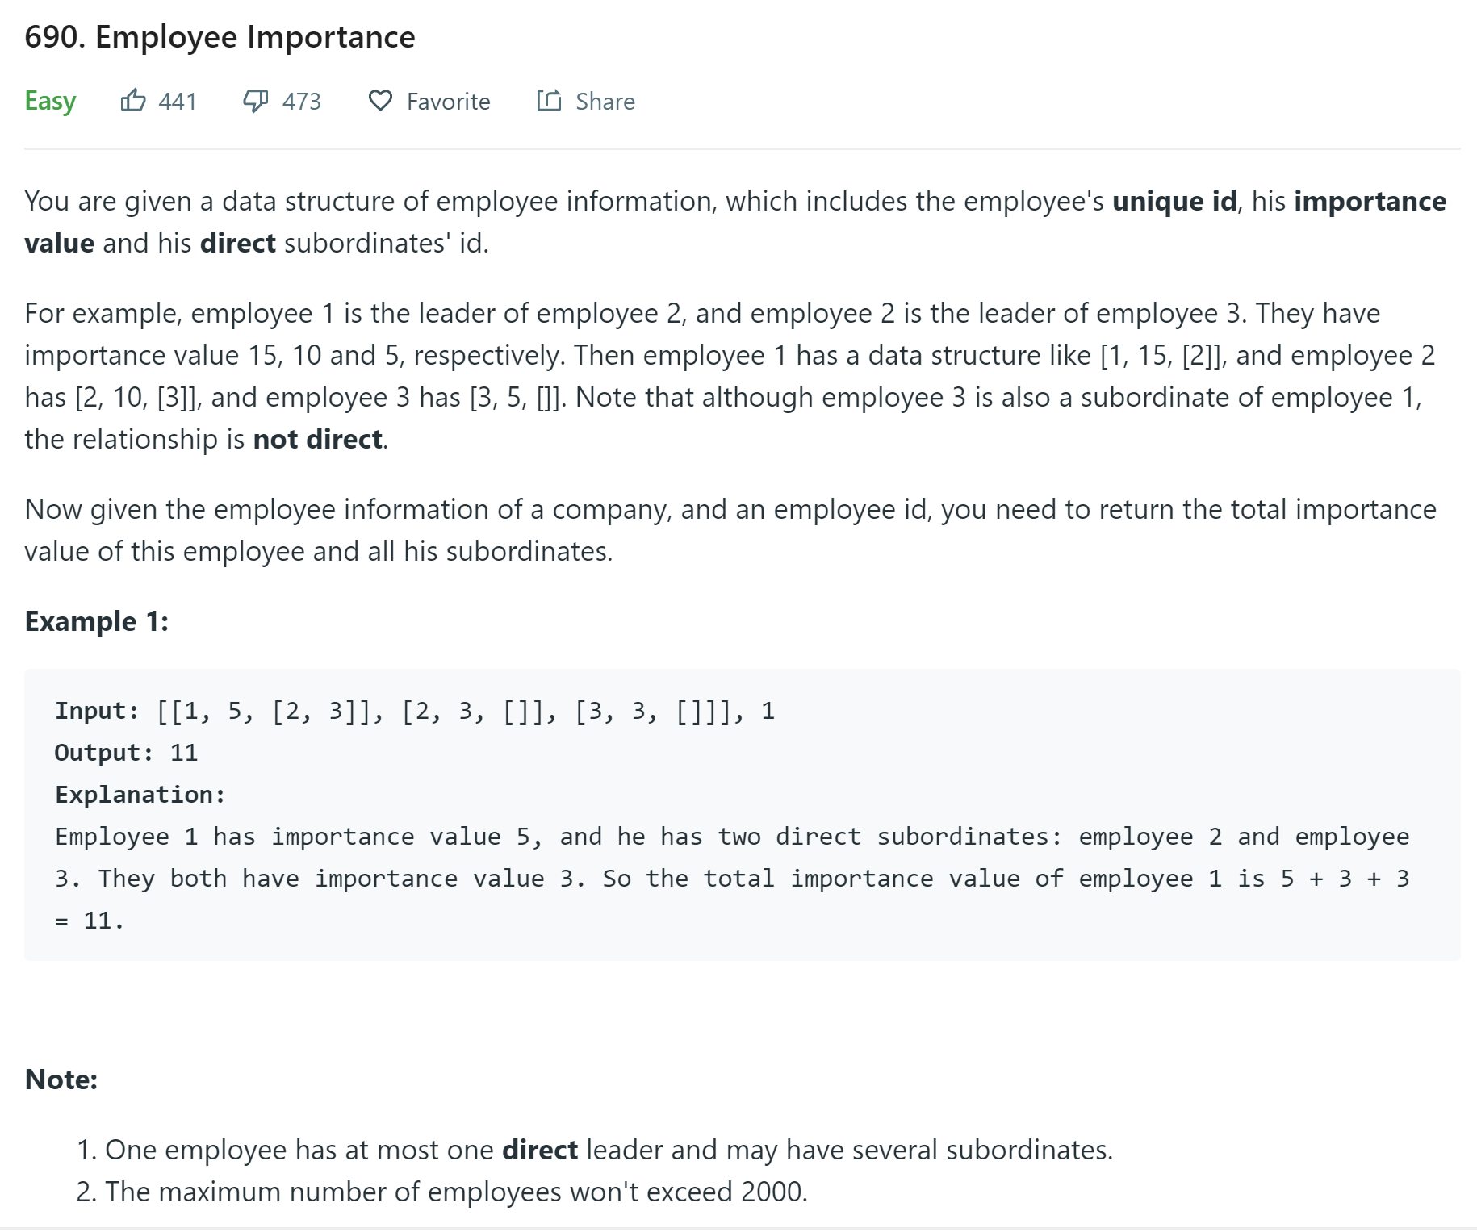

Slide 14
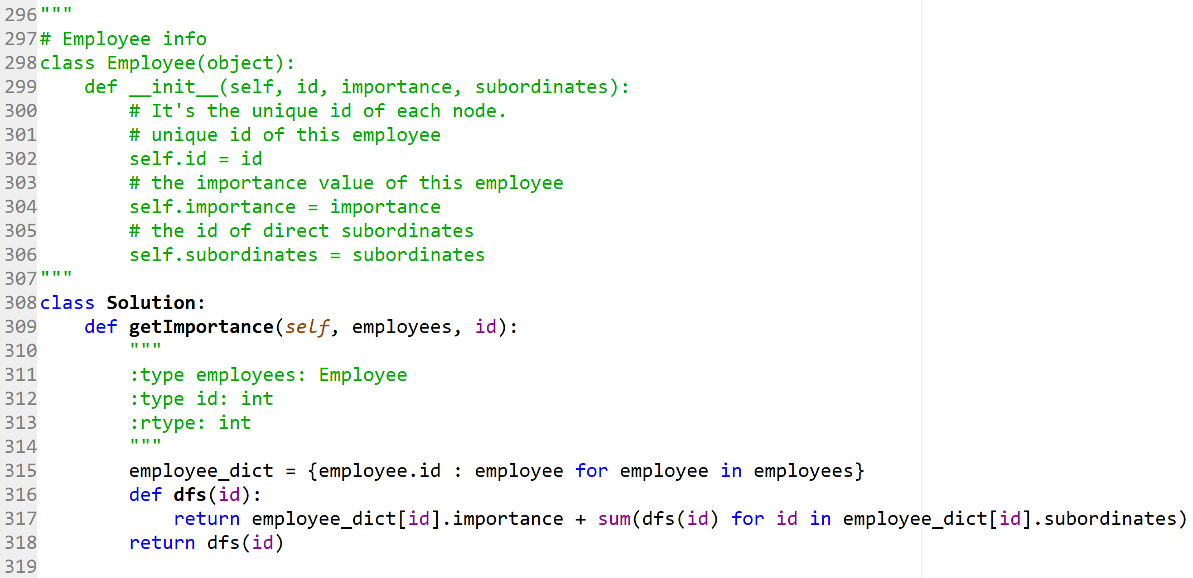

Slide 15
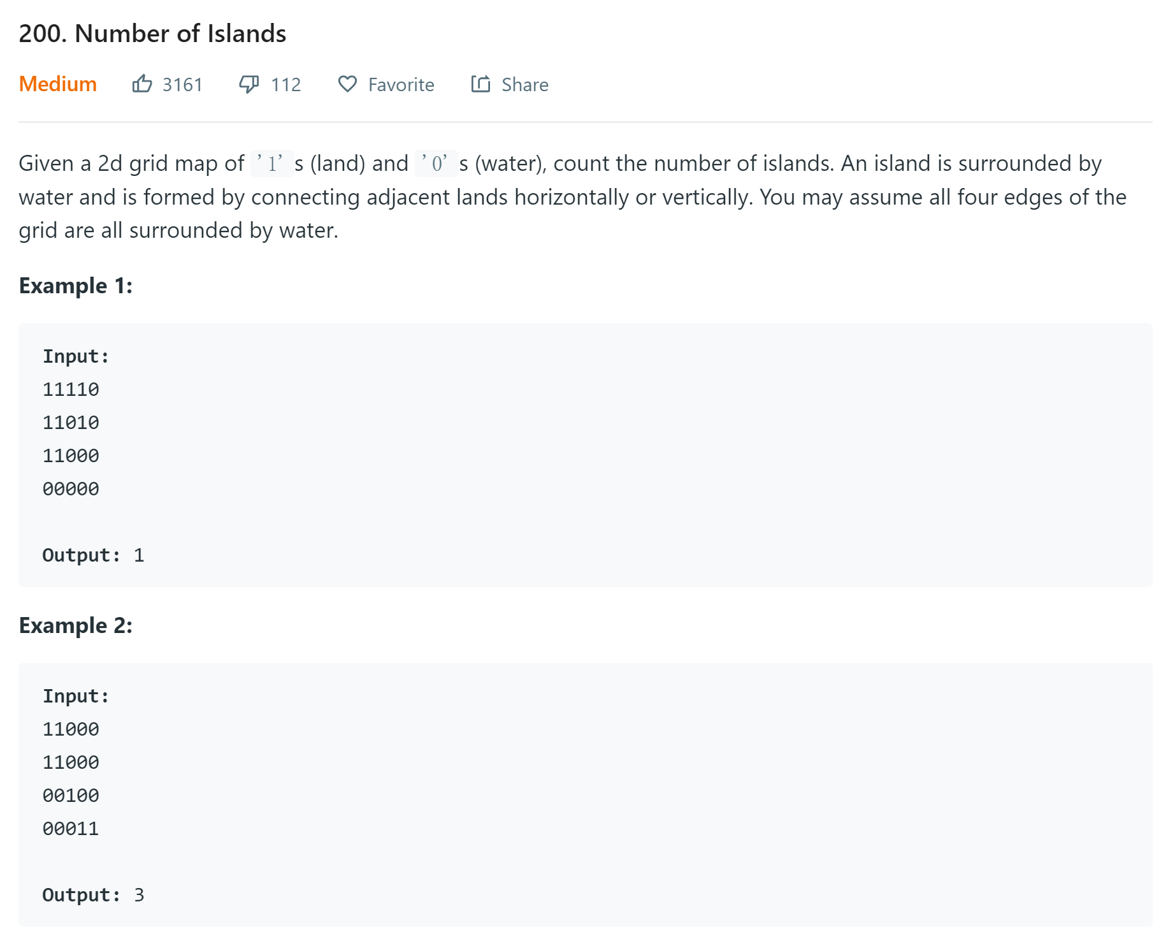
Number of Islands
https://leetcode.com/problems/number-of-islands/description/

Slide 16
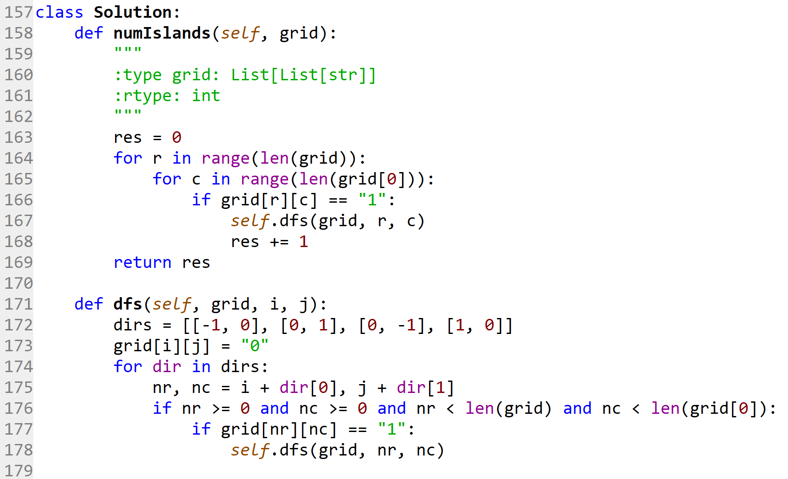
Solution
Iterate through each of the cell and if it is an island(“1”), do DFS to mark all adjacent islands(“1”) as “0”, then increase the counter by 1.
The number of islands equals to how many times we do DFS

